Slide 1
Spring Data Redis
2016/10/14
Aiden

Slide 2
Redis
Redis 是一個 Key-Value 存儲系統。和 Memcached 類似，它支持存儲的 value 類型相對更多，包括 string(字符串)、 list(鏈表)、set(集合)、 zset(有序集合) 、點陣圖(bitmap)和超重對數(hyperloglog)
重要功能：
Redis HA
Serializers
Message
Transaction
Cache
Redis採用記憶體 (in-memory) 資料集 (dataset)
根據使用場景，可以通過每隔一段時間轉儲資料集到磁片，或者追加每條命令到日誌來持久化(persistence)
Redis 3.2.4 is the latest stable version

Slide 3
Spring Data
希望提供除了 RDBMS 之外更多不同的資料存取方式
Redis vs Jedis vs Spring Data Redis
Redis是用ANSI C寫的一個基於 memory 的Key-Value數據庫
而Jedis是Redis官方推出的面向Java的Client，提供了很多接口和方法，可以讓Java操作使用Redis
Spring Data Redis是對Jedis進行了封裝，集成了Jedis的一些命令和方法，可以與Spring整合

Slide 4
Redis Requirements
requires Redis 2.6 or above and Java SE 6.0 or above
Spring Redis integrates with Jedis, JRedis (Deprecated since 1.7), SRP (Deprecated since 1.7) and Lettuce

Slide 5

Connecting to Redis
there is only one set of Spring Data Redis API that one needs to use
org.springframework.data.redis.connection package and its RedisConnection and RedisConnectionFactory interfaces for working with and retrieving active connections to Redis.
RedisConnection
automatically translates the underlying connecting library to Spring’s consistent DAO exception
For the corner cases where the native library API is required, RedisConnection provides a dedicated method getNativeConnection which returns the raw
RedisConnectionFactory
Active RedisConnection s are created through
Depending on the underlying configuration, the factory can return a new connection or an existing connection
UnsupportedOperationException
Invoking a method on the Connection API that is unsupported by the underlying library

Slide 6
Configuring Jedis connector
Jedis Basic configuration
With host or password
<?xml version="1.0" encoding="UTF-8"?> <beans xmlns="http://www.springframework.org/schema/beans" xmlns:xsi="http://www.w3.org/2001/XMLSchema-instance" xsi:schemaLocation="http://www.springframework.org/schema/beans http://www.springframework.org/schema/beans/spring-beans.xsd">
<!-- Jedis ConnectionFactory -->
<bean id="jedisConnectionFactory" class="org.springframework.data.redis.connection.jedis.JedisConnectionFactory"/> </beans>
<?xml version="1.0" encoding="UTF-8"?> <beans xmlns="http://www.springframework.org/schema/beans" xmlns:xsi="http://www.w3.org/2001/XMLSchema-instance" xmlns:p="http://www.springframework.org/schema/p" xsi:schemaLocation="http://www.springframework.org/schema/beans http://www.springframework.org/schema/beans/spring-beans.xsd">
<bean id="jedisConnectionFactory" class="org.springframework.data.redis.connection.jedis.JedisConnectionFactory" p:host-name="server" p:port="6379" /> </beans>

Slide 7
Redis Sentinel Support
support for Redis Sentinel using RedisSentinelConfiguration dealing with high available Redis
RedisSentinelConfiguration can also be defined via PropertySource.
spring.redis.sentinel.master: name of the master node.
spring.redis.sentinel.nodes: Comma delimited list of host:port pairs.
access to the first active Sentinel configured.
RedisConnectionFactory.getSentinelConnection()
RedisConnection.getSentinelCommands()
/** * jedis */
@Bean
public RedisConnectionFactory jedisConnectionFactory() {
RedisSentinelConfiguration sentinelConfig = new RedisSentinelConfiguration().master("mymaster") .sentinel("127.0.0.1", 26379).sentinel("127.0.0.1", 26380);
return new JedisConnectionFactory(sentinelConfig); }
Notes:
Sometimes direct interaction with the one of the Sentinels is required. Using RedisConnectionFactory.getSentinelConnection() orRedisConnection.getSentinelCommands() gives you access to the first active Sentinel configured.

Slide 8
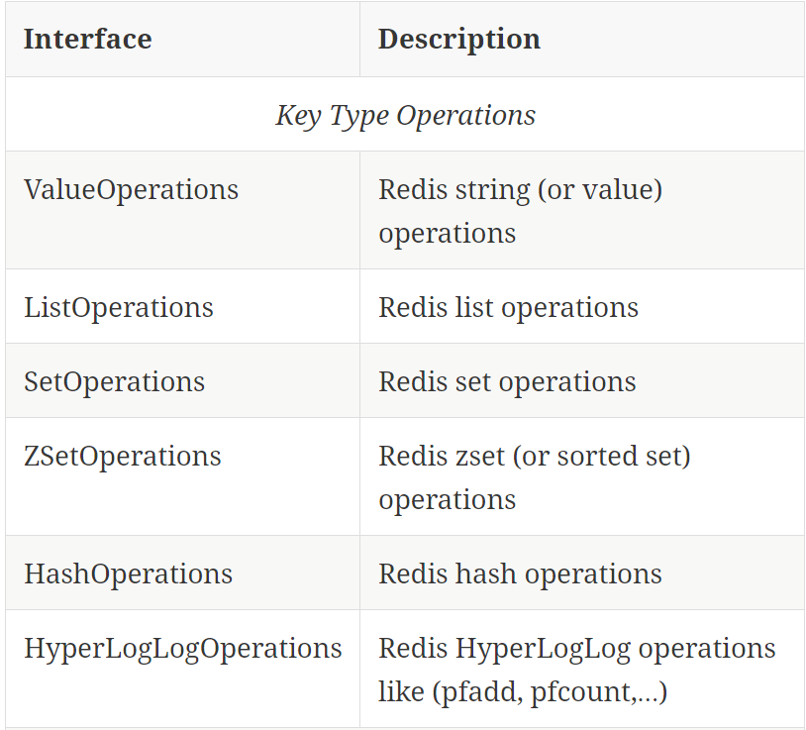
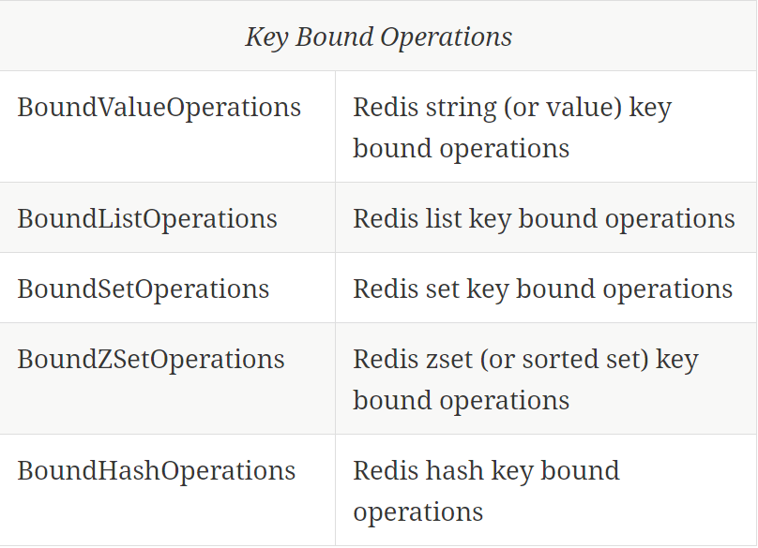
Working with Objects through RedisTemplate
RedisTemplate is in fact the central class of the Redis module due to its rich feature set
the template provides operations views, that offer rich, generified interfaces for working against a certain type or certain key

Slide 9
Working with Objects through RedisTemplate (cont’d)
the template is thread-safe and can be reused across multiple instances
uses a Java-based serializer for most of its operations, any object written or read by the template will be serialized /deserialized through Java
serialization mechanism can be easily changed on the template
org.springframework.data.redis.serializer see Serializers
set any of the serializers to null and use RedisTemplate with raw byte arrays by setting the enableDefaultSerializer property to false
template requires all keys to be non-null - values can be null as long as the underlying serializer accepts them

Slide 10
Working with Objects through RedisTemplate (cont’d)
<?xml version="1.0" encoding="UTF-8"?> <beans xmlns="http://www.springframework.org/schema/beans" xmlns:xsi="http://www.w3.org/2001/XMLSchema-instance" xmlns:p="http://www.springframework.org/schema/p" xsi:schemaLocation="http://www.springframework.org/schema/beans http://www.springframework.org/schema/beans/spring-beans.xsd"> <bean id="jedisConnectionFactory" class="org.springframework.data.redis.connection.jedis.JedisConnectionFactory" p:use-pool="true"/>
<!-- redis template definition -->
<bean id="redisTemplate" class="org.springframework.data.redis.core.RedisTemplate" p:connection-factory-ref="jedisConnectionFactory"/> ...
</beans>
public class Example {
// inject the actual template
@Autowired
private RedisTemplate<String, String> template;
// inject the template as ListOperations
@Resource(name="redisTemplate")
private ListOperations<String, String> listOps;
public void addLink(String userId, URL url) {
listOps.leftPush(userId, url.toExternalForm());
}
}

Slide 11
String-focused convenience classes
Redis modules provides two extensions to RedisConnection and RedisTemplate respectively the StringRedisConnection and StringRedisTemplate as a convenient one-stop solution for intensive String operations.
the template and the connection use the StringRedisSerializer underneath which means the stored keys and values are human readable

Slide 12
String-focused convenience classes（cont’d）
<?xml version="1.0" encoding="UTF-8"?> <beans xmlns="http://www.springframework.org/schema/beans" xmlns:xsi="http://www.w3.org/2001/XMLSchema-instance" xmlns:p="http://www.springframework.org/schema/p" xsi:schemaLocation="http://www.springframework.org/schema/beans http://www.springframework.org/schema/beans/spring-beans.xsd">
<bean id="jedisConnectionFactory" class="org.springframework.data.redis.connection.jedis.JedisConnectionFactory" p:use-pool="true"/>
<bean id="stringRedisTemplate" class="org.springframework.data.redis.core.StringRedisTemplate" p:connection-factory-ref="jedisConnectionFactory"/> ...
</beans>
public class Example {
@Autowired
private StringRedisTemplate redisTemplate;
public void addLink(String userId, URL url)
redisTemplate.opsForList().leftPush(userId, url.toExternalForm());
}
}

Slide 13
Serializers
the data stored in Redis is just bytes
whether the information gets translated into Strings or any other objects
conversion between the user (custom) types and raw data (and vice-versa) is handled in Spring Data Redis through the RedisSerializer interface
JSON format
OxmSerializer for Object/XML mapping through Spring 3 OXM support or either JacksonJsonRedisSerializer, Jackson2JsonRedisSerializer or GenericJackson2JsonRedisSerializer
the storage format is not limited only to values - it can be used for keys, values or hashes without any restrictions.

Slide 14
Redis Messaging/PubSub
Spring Data provides dedicated messaging integration for Redis
similar in functionality and naming to the JMS integration in Spring Framework
Redis messaging can be roughly divided into two areas of functionality
production or publication
consumption or subscription
RedisTemplate class is used for message production
asynchronous vs synchronous
Async：provides a dedicated message listener container that is used to create Message-Driven POJOs (MDPs)
Sync：RedisConnection contract.

Slide 15
Sending/Publishing messages
Package
org.springframework.data.redis.connection
org.springframework.data.redis.listener
offer the publish method to publish a message
Low-level：RedisConnection，requires raw-data (array of bytes)
High-level：RedisTemplate，RedisTemplate allow arbitrary objects
// send message through connection RedisConnection con = ...
byte[] msg = ...
byte[] channel = ...
con.publish(msg, channel); // send message through RedisTemplate RedisTemplate template = ...
template.convertAndSend("hello!", "world");

Slide 16
Receiving/Subscribing for messages
subscribe to one or multiple channels either by naming them directly or by using pattern matching
allows multiple subscriptions to be created with one command
listen on channels not yet created at subscription time
RedisConnection
offers subscribe and pSubscribe methods that map the Redis commands for subscribing by channel respectively by pattern
simply query whether it is listening or not, RedisConnection provides getSubscription and isSubscribed method.
Subscription commands in Spring Data Redis are blocking
calling subscribe on a connection will cause the current thread to block as it will start waiting for messages
the thread will be released only if the subscription is canceled
that is an additional thread invokes unsubscribe or pUnsubscribe on the same connection

Slide 17
Receiving/Subscribing for messages (cont’d)
In order to subscribe for messages, one needs to implement the MessageListener callback
each time a new message arrives, the callback gets invoked and the user code executed through onMessage method
The interface gives access not only to the actual message but to the channel it has been received through
the pattern (if any) used by the subscription to match the channel

Slide 18
Message Listener Containers
low-level subscription requires connection and thread management for every single listener
acts as a message listener container
used to receive messages from a Redis channel and drive the MessageListener that are injected into it
responsible for all threading of message reception and dispatches into the listener for processing
is the intermediary between an MDP and a messaging provider and takes care of registering to receive messages, resource acquisition and release, exception conversion
allows one connection and one thread to be shared by multiple listeners even though they do not share a subscription

Slide 19
Message Listener Containers(cont’d)
no matter how many listeners or channels an application tracks, the runtime cost will remain the same through out its lifetime
allows runtime configuration changes so one can add or remove listeners while an application is running
uses a lazy subscription approach, using a RedisConnection only when needed - if all the listeners are unsubscribed, cleanup is automatically performed and the used thread released.
To help with the asynch manner of messages, the container requires a java.util.concurrent.Executor ( or Spring’s TaskExecutor)
it is highly recommended to pick a proper TaskExecutor to take advantage of its runtime.

Slide 20
The MessageListenerAdapter
the final component in Spring’s asynchronous messaging support
allows you to expose almost any class as a MDP(of course some constraints)
although the interface doesn’t extend the MessageListener interface can still be used as a MDP via the use of the MessageListenerAdapter class
the channel or pattern to which a message is sent can be passed in to the method as the second argument of type String
public interface MessageDelegate {
void handleMessage(String message);
void handleMessage(Map message);
void handleMessage(byte[] message);
void handleMessage(Serializable message);
// pass the channel/pattern as well
void handleMessage(Serializable message, String channel); }

Slide 21
The MessageListenerAdapter(cont’d)
uses the Redis namespace to declare the message listener container and automatically register the POJOs as listeners
<?xml version="1.0" encoding="UTF-8"?>
<beans xmlns="http://www.springframework.org/schema/beans" xmlns:xsi="http://www.w3.org/2001/XMLSchema-instance" xmlns:redis="http://www.springframework.org/schema/redis" xsi:schemaLocation="http://www.springframework.org/schema/beans http://www.springframework.org/schema/beans/spring-beans.xsd http://www.springframework.org/schema/redis http://www.springframework.org/schema/redis/spring-redis.xsd">
<!-- the default ConnectionFactory -->
<redis:listener-container>
<!-- the method attribute can be skipped as the default method name is "handleMessage" -->
<redis:listener ref="listener" method="handleMessage" topic="chatroom" /> </redis:listener-container> <bean id="listener" class="redisexample.DefaultMessageDelegate"/> ... <beans>
The listener topic can be either a channel (e.g. topic="chatroom") or a pattern (e.g. topic="*room")

Slide 22
The MessageListenerAdapter(cont’d)
The full blown, beans definition is displayed below:
<bean id="messageListener" class="org.springframework.data.redis.listener.adapter.MessageListenerAdapter">
<constructor-arg>
<bean class="redisexample.DefaultMessageDelegate"/>
</constructor-arg>
</bean>
<bean id="redisContainer" class="org.springframework.data.redis.listener.RedisMessageListenerContainer">
<property name="connectionFactory" ref="connectionFactory"/> <property name="messageListeners">
<map>
<entry key-ref="messageListener">
<bean class="org.springframework.data.redis.listener.ChannelTopic">
<constructor-arg value="chatroom">
</bean> </entry> </map> </property> </bean>
Each time a message is received, the adapter automatically performs translation between the low-level format and the required object type transparently
Any exception caused by the method invocation is caught and handled by the container (by default, being logged).

Slide 23
Redis Transactions
Redis provides support for transactions through the multi, exec, and discard commands
These operations are available on RedisTemplate, however RedisTemplate is not guaranteed to execute all operations in the transaction using the same connection
Spring Data Redis provides the SessionCallback interface for use when multiple operations need to be performed with the same connection
//execute a transaction
List<Object> txResults = redisTemplate.execute(new SessionCallback<List<Object>>() {
public List<Object> execute(RedisOperations operations) throws DataAccessException {
operations.multi();
operations.opsForSet().add("key", "value1");
// This will contain the results of all ops in the transaction
return operations.exec();
}
});
System.out.println("Number of items added to set: " + txResults.get(0));

Slide 24
Redis Transactions(cont’d)
RedisTemplate will use its value, hash key, and hash value serializers to deserialize all results of exec before returning.
an additional exec method that allows you to pass a custom serializer for transaction results.

Slide 25
@Transactional Support
Transaction Support is disabled by default and has to be explicitly enabled for each RedisTemplate in use by setting setEnableTransactionSupport(true).
This will force binding the RedisConnection in use to the current Thread triggering MULTI
If the transaction finishes without errors, EXEC is called, otherwise DISCARD
once in MULTI, RedisConnection would queue write operations, all readonly operations, such as KEYS are piped to a fresh (non thread bound) RedisConnection.

Slide 26
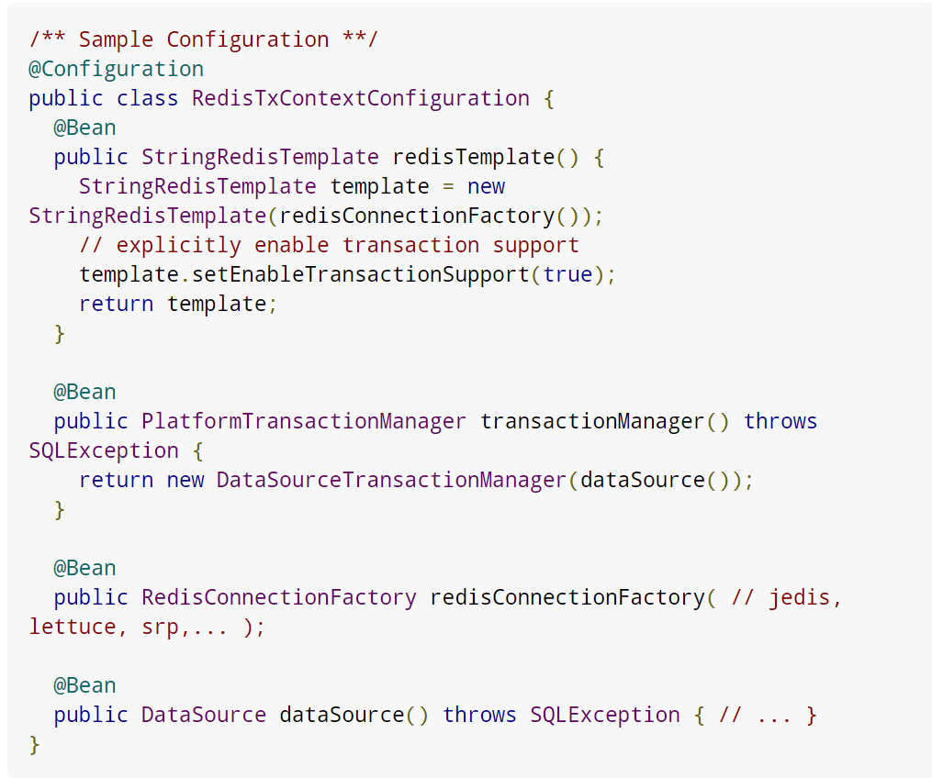
@Transactional Support(cont’d)

Slide 27
Pipelining
Redis provides support for pipelining, which involves sending multiple commands to the server without waiting for the replies and then reading the replies in a single step
Pipelining can improve performance when you need to send several commands in a row, such as adding many elements to the same List.
several RedisTemplate methods for executing commands in a pipeline
don’t care about the results：use the standard execute method, passing true for the pipeline argument
The executePipelined methods will execute the provided RedisCallback or SessionCallback in a pipeline and return the results

Slide 28
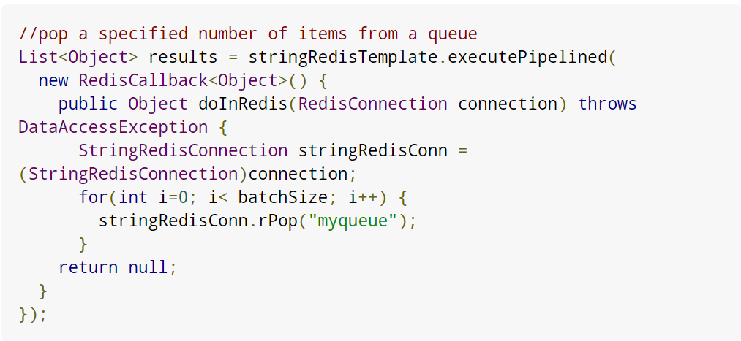
Pipelining(cont’d)
RedisTemplate uses its value, hash key, and hash value serializers to deserialize all results before returning, so the returned items in the above example will be Strings
additional executePipelined methods that allow you to pass a custom serializer for pipelined results.

Slide 29
Redis Scripting
Redis versions 2.6 and higher provide support for execution of Lua scripts through the eval and evalsha commands
Scripts can be run through the execute methods of RedisTemplate
ScriptExecutor
to execute the provided script
takes care of serializing the provided keys and arguments and deserializing the script result an
additional execute method that allows you to pass custom serializers for the script arguments and result
ScriptExecutor optimizes performance by retrieving the SHA1 of the script

Slide 30
Support Classes
org.springframework.data.redis.support
offers various reusable components that rely on Redis as a backing store
the package contains various JDK-based interface implementations on top of Redis such as atomic counters and JDK Collections
The atomic counters make it easy to wrap Redis key incrementation while the collections allow easy management of Redis keys with minimal storage exposure or API leakage
in particular the RedisSet and RedisZSet interfaces offer easy access to the set operations supported by Redis
such as intersection and union while RedisList implements the List, Queue and Deque contracts (and their equivalent blocking siblings) on top of Redis

Slide 31
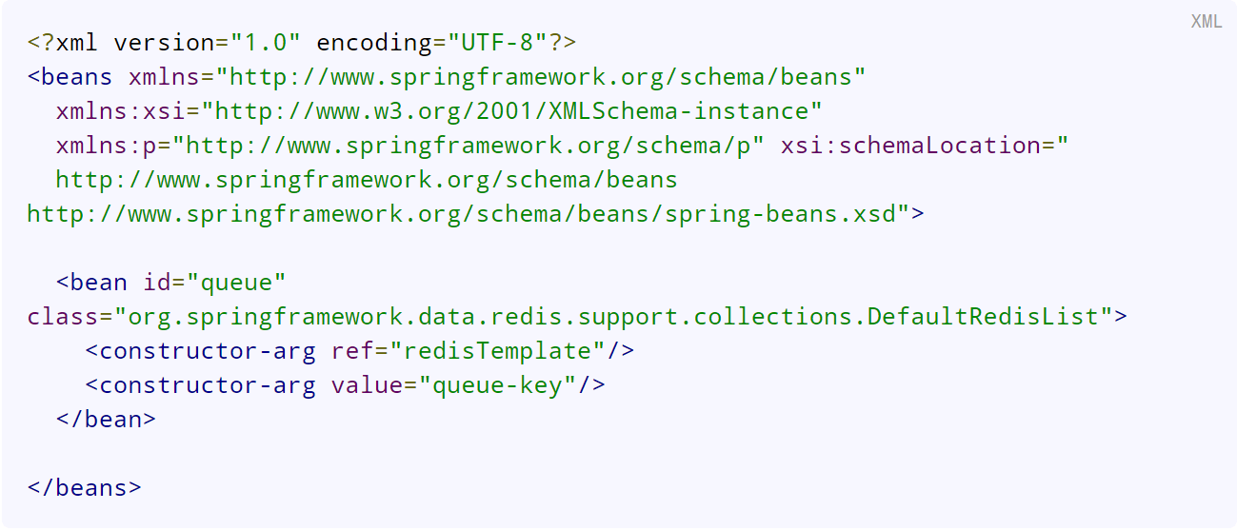
Support Classes(cont’d)
exposing the storage as a FIFO (First-In-First-Out), LIFO (Last-In-First-Out) or capped collection with minimal configuration:

Slide 32
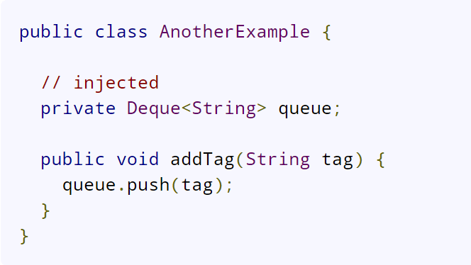
Support Classes(cont’d)
the consuming code is decoupled from the actual storage implementation
in fact there is no indication that Redis is used underneath
This makes moving from development to production environments transparent and highly increases testability
the Redis implementation can just as well be replaced with an in-memory one

Slide 33
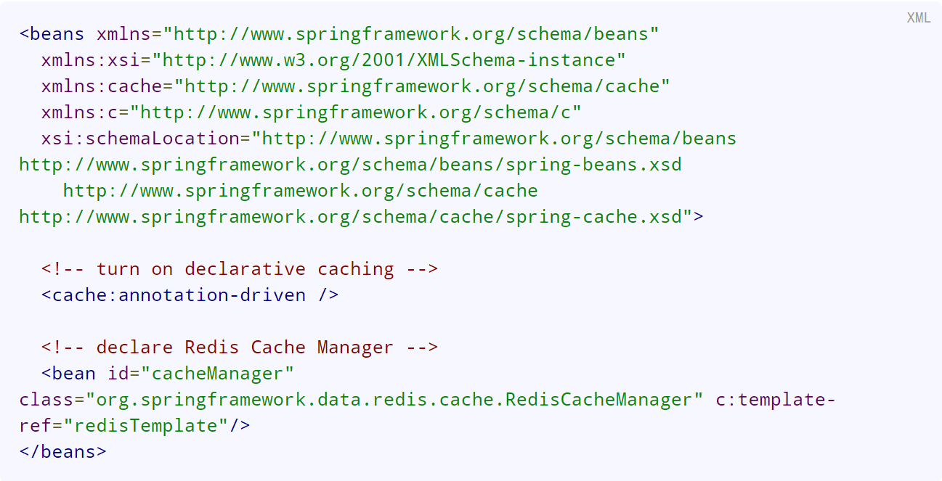
Support for Spring Cache Abstraction
Spring Redis provides an implementation for Spring cache abstraction
org.springframework.data.redis.cache
To use Redis as a backing implementation, simply add RedisCacheManager to your configuration

Slide 34
Support for Spring Cache Abstraction
By default RedisCacheManager will lazily initialize RedisCache whenever a Cache is requested.
can be changed by predefining a Set of cache names.
By default RedisCacheManager will not participate in any ongoing transaction.
Use setTransactionAware to enable transaction support.
By default RedisCacheManager does not prefix keys for cache regions, which can lead to an unexpected growth of a ZSET used to maintain known keys.
highly recommended to enable the usage of prefixes in order to avoid this unexpected growth and potential key clashes using more than one cache region.

